Slide 1
My Learning Journal
Parent Workshop
Friday 28th April 2017

Slide 2
Parent Feedback – March 2017
Highlights
Staff are friendly and approachable
My child loves coming to Nursery
Continue the good work following the children’s interests
My child is happy and content and I feel the nursery has fostered independence and confidence in my child

Slide 3
Parent Feedback – March 2017
Points to work on
Communication between parents and nursery could be improved
Put stickers on children showing what they have been doing that day
Annual trip for the children
Parking
Notices being missed

Slide 4
What have we actioned?
Allocated parking at side of school
Annual trip booked to Briarsland Farm for all nursery children on May 3rd
Notices on our new and improved school website and Twitter – please follow us on Twitter @muiredgeprimary to see our nursery page
And why we are here today…

Slide 5
https://www.learningjournals.co.uk

Slide 6
My Learning Journal
Learning Journals started back in late 2011 at Arbor Green Nursery in Edinburgh. Owners Natalie and David Clark were discussing how difficult it was for staff to be able to complete the learning journeys for the children. Using a paper and pen based system it was simply too demanding for them to be able to accurately document and track each child’s learning to the high standards required by the nursery, the local authority, Education Scotland and the Care Inspectorate.

Slide 7
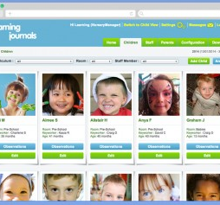
What Does it look like for Nursery?
Each child has their own Learning Journal account
Each parent has a unique login to see their child’s progress
The staff complete observations and publish these on each child’s journal
You need internet access to view or alternatively they can be printed out

Slide 8
First thing’s first – check your emails!
Check your emails for messages received from:
learningjournals@yourlearningjournals.co.uk
Any parent notification emails you have received will contain a link directly to your account – give it a click.

Slide 9
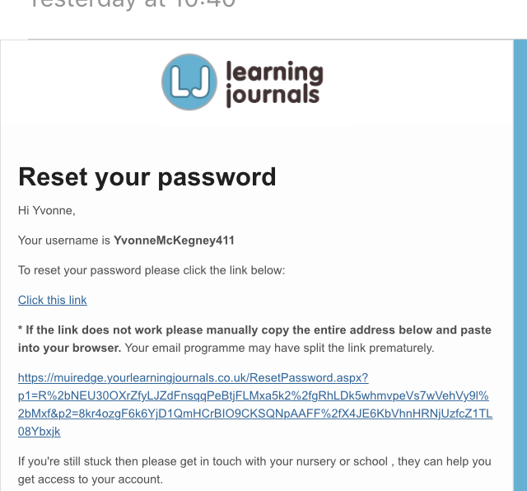
Your Login Details
When your account is live you will receive this email.
You click on the link and log in with the username shown at the top of the email.
You will then be asked to set your own password too. Take a note of these.

Slide 10
Pin number
You will then be asked to create your own 4 digit pin number – take note of this too.

Slide 11
Important log in details you need to access Learning Journals
Username – on the email
Password – one you will remember
Pin – 4 Digits you will remember

Slide 12
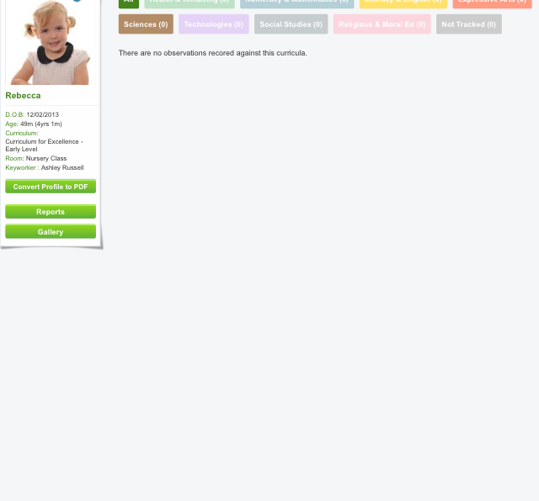
Your child’s profile
This is what you will see when you log in for the first time.
There will be no observations recorded from staff until May.

Slide 13
Instant Access from Anywhere
One of the main reasons for using Learning Journals is parents so often never have the time to come in to the nursery to look at, or comment on, their children’s folders. With this system you can securely log in from wherever you are – at work, late at night at home, or even on the bus. You can instantly leave comments and feedback proving that nurseries have a really strong link with the home.
The system works across all platforms so you are not tied to any particular hardware or device.

Slide 14
Tracking for Staff
Learning Journals takes tracking to a whole new level that was never possible with paper based systems. You can now view a chart of progress for each child and easily identify areas where they require more support. It is easy to spot gaps in learning and almost impossible for a child to be overlooked or forgotten.
Staff say: "As a management tool Learning Journals has become so valuable as it saves us so much time and gives us a much better overview of the children's development."

Slide 15
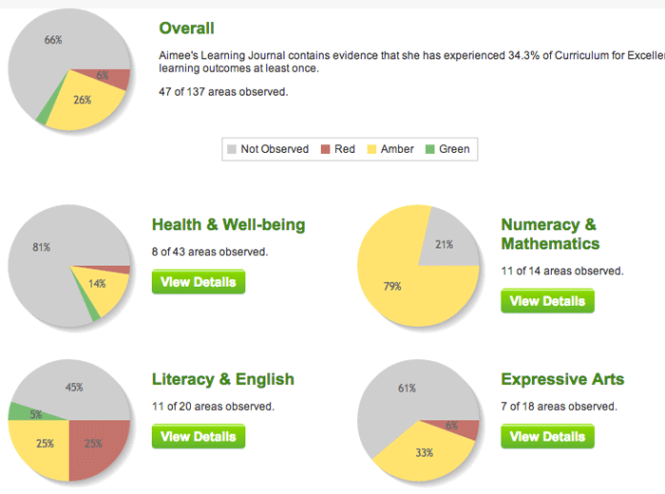

Slide 16
Security is a top priority
It is extremely important to us that your data remains safe and secure at all times. Every user has their own unique username, password and PIN combination. Every account uses its own separate web address. Each address has en encryption certificate (or SSL certificate) that scrambles the data as it is sent from your device to the Learning Journals servers.
Constant backups mean that should the very worst happen, however unlikely that might be, we would still be able to recover all data.
In addition, they use the powerful and imposing Microsoft Windows Azure platform to keep all our data safe in a constantly backed up state across many different European locations.

Slide 17
Muiredge Nursery Trial
30 day free trial starts in May 2017 https://www.learningjournals.co.uk
All children, staff and parents are added and ready to go
You will receive an email with your own login username and then you create your own password and pin – please let us know if your email has changed
Each keyworker will be responsible for their own group

Slide 18
Feedback in June
We will ask for feedback in June when the free trial period ends.
Any questions, you can contact the school or email me at gw09bokassharon01@glow.sch.uk
Please remember this is a trial for all of us and there may be some glitches but we are very excited about trying out Learning Journals.

Slide 19
Thank you for coming today

